Slide 1
Officer Club Training 2021: Cultivating A Mindset for Success
Club Success Plan
Moments of Truth
Tools for Success

Slide 2
Poll Everywhere
Get out your device and go to in your browser
PollEV.com/matthewville304
D106

Slide 3
Officer Club Training 2021: Cultivating A Mindset for Success
Objectives:
You’re going to get a lot of things out of today’s session…
We are going to give you the big picture of your role in cultivating the success of your club.
We are going to shift your mindset to cultivate success.
We are going to review the tools that Toastmasters gives us to cultivate the success of our clubs.
We are going to create a link between the knowledge and tools you gain as a club officer and success in your own life – we call these transferable skills.
We are going to help you understand your role as club officer.
D106

Slide 4
(Source: https://thriveglobal.com/stories/qualities-of-a-good-business-leader/)
Show of hands: How many people in the room manage your own business?
D106

Slide 5
Mindset For Success
(Source: https://www.startupguys.net/5-ways-to-develop-a-mindset-for-success/)
Write in the chat: what do you think is the key ingredient for cultivating a mindset for success?
D106

Slide 6
Your Strengths
D106

Slide 7
Planning
(Source: https://thinkwealthmagazine.com/marketing-road-map-success/)
Show of hands: How many of you would most likely write a business plan before starting your small business?
D106

Slide 8
Your Club Success Plan is your business plan!
D106

Slide 9
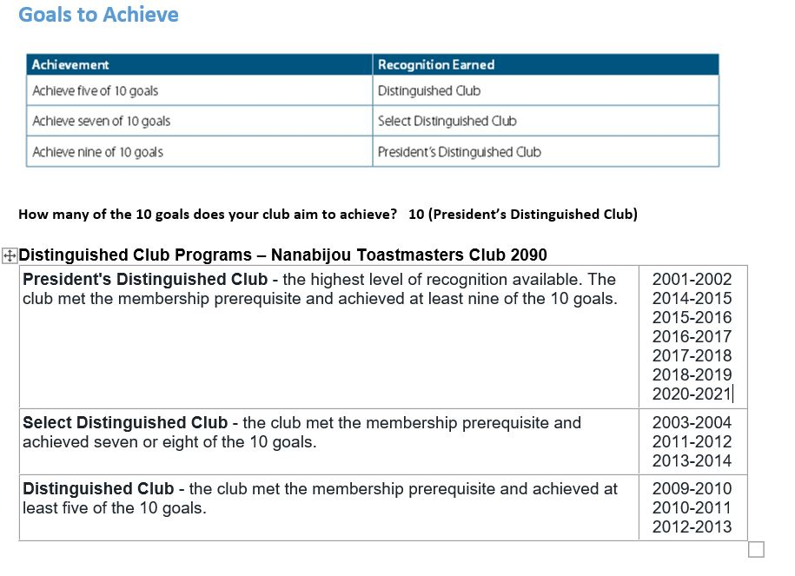
Distinguished Club Program
D106

Slide 10
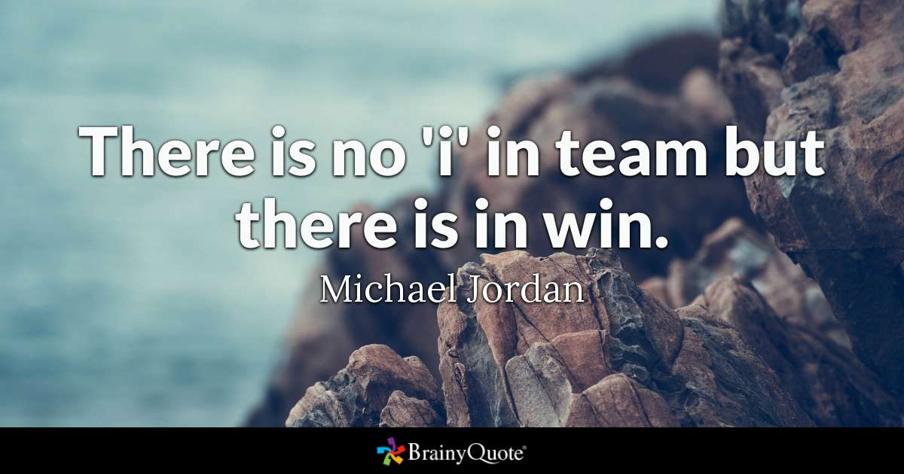
(Source: https://www.brainyquote.com/quotes/michael_jordan_379019)
“There’s No “I” In Team, But There’s A “You” In Influencer”
D106

Slide 11
D106

Slide 12
This Moment of Truth
In the chat box tell me: What are the challenges/barriers your club faces with completing a Club Success Plan?
D106

Slide 13
Calls to Action
Identify your strengths, your member’s strengths, your club’s strengths
New Member Profile Sheet: https://www.toastmasters.org/resources/new-member-profile-sheet
Pathways ice breaker speech or table topics
2. Complete or update your Club Success Plan (business plan)
Distinguished Club Plan and Club Success Plan: https://www.toastmasters.org/Resources/Distinguished-Club-Program-and-Club-Success-Plan-English
3. Evaluate your club
Moments of Truth: https://www.toastmasters.org/Resources/Moments-of-Truth
4. Review your Club Success Plan regularly
Create a shared drive for your club in Google Docs
5. Celebrate your success!
D106

Slide 14
Additional Tools:
Club Leadership Handbook (District 106 website): http://d106tm.org/wp-content/uploads/2018/10/1310-Club-Leadership-Handbook-1.pdf
Next up: Pathways presentation­­­…
D106

